Slide 1

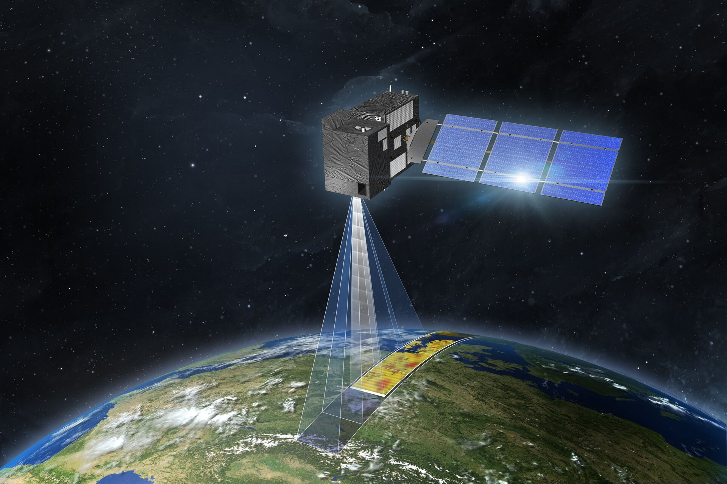

Space based CO2 concentration monitoring
Team name: G3
Member: Daniel Odido, Rohith Shivashankar, Kerim Hadžić, Arno Barnard

Slide 2
Table of Contents
Mission Statement
System Design
Management
Demonstration
4.1 Experimental Setup: Planned vs Performed
4.2 Experimental Results
Physical – Parachute
Physical – CO2 GS Mode
Physical – LEDs, Sound
Operational – Satellite Bus Verification
Operational – CO2 Sensors
Operational – LEDs, Sound
Operational – Python GS User Interface
Functional – CO2 Software: Node + GS
Functional – Parachute release with dummy weight
Functional
End to End Testing – CO2 Sensor
End to End Testing – LEDs for Landing
End to End Testing - System
4.3 Summary of Success Evaluation
Conclusion

Slide 3

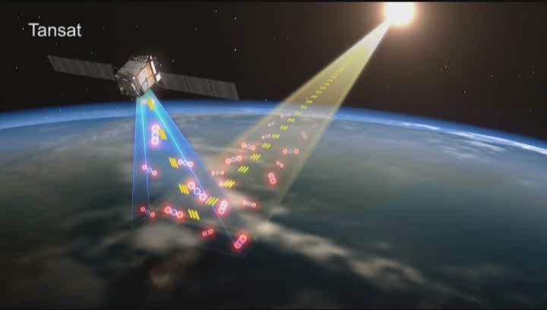
Mission System Design > 1. Mission Statement
1.1 User Needs / Background
The major threat from increased CO₂ is the greenhouse effect. As a greenhouse gas, excessive CO₂ creates a cover that traps the sun's heat energy in the atmospheric bubble, warming the planet and the oceans.
One way to measure the CO₂ in Space is including air quality sensor to Satellite .
The main objective of the mission is to Monitor the carbon dioxide in the space through satellite to understand climate change at different time, altitudes and compare the carbon dioxide content with ground station.

Slide 4
Mission System Design > 1. Mission Statement
1.2 Sketch / Mission Statement
Clarify objectives
To set up a satellite system to monitor atmospheric concentration of carbon dioxide
By sensing the concentration of carbon dioxide by sensors installed on the computer
Using HEPTA-Sat with carbon dioxide sensor supported by a ground node
Mission Goals
[MG1] Establish successful measurement of CO2 concentration at specified altitude
[MG2] Establish successful measurement of CO2 concentration at ground node
[MG3] Relay the measured values of CO2 concentration to the Ground Station

Slide 5
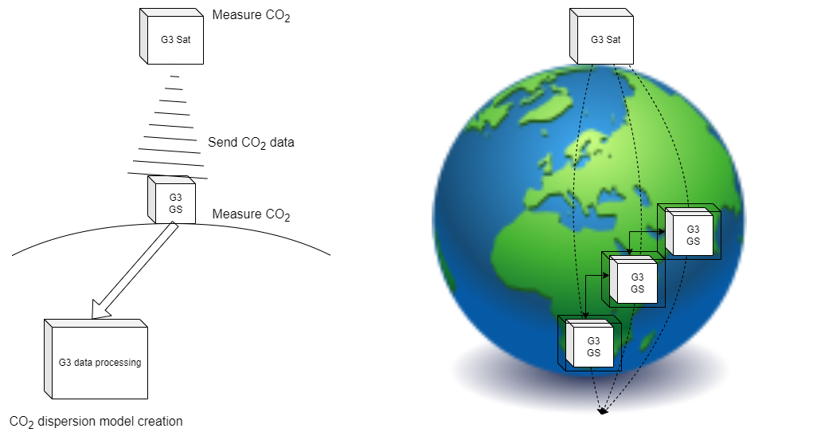
Mission System Design > 1. Mission Statement
1.2 Sketch / Mission Statement

Slide 6
Mission System Design > 1. Mission Statement
1.3 Success Criteria
Success Level | Goal No. | Mission Success Criteria | Verification Method
Minimum Success | 1 | Establish the communication between Stellite and GS | Switch on the satellite and HK Data Received
 | 2 | Get the CO2 data from Satellite | CO2 data from Satellite is Received Successfully
 | 3
Full Success | 4 | Establish the communication between Stellite and GS | Switch on the satellite and House Keeping Data Received
 | 5 | Get the CO2 data from Satellite at the specified interval of time to GS | CO2 data from Satellite is Received Successfully
 | 6 | Detect landing condition | LED and Sound data received
Advanced Success | 7 | Establish the communication between Stellite and different GS | Switch on the satellite and House Keeping Data Received
 | 8 | Get the CO2 data from Satellite at the specified interval of time from Different GS and Compare the results | CO2 data from Satellite is Received to all the GS station Successfully
 | 9 | Detect landing condition and measure the force of impact of the ground (through acceleration) | LED and sound data is received

Slide 7
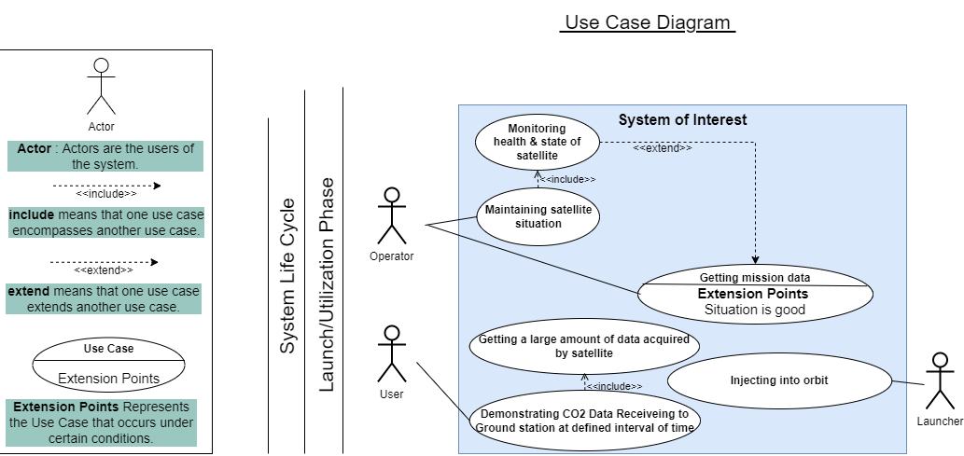
Mission System Design > 2. System Design
2.1 Use Case Diagram

Slide 8
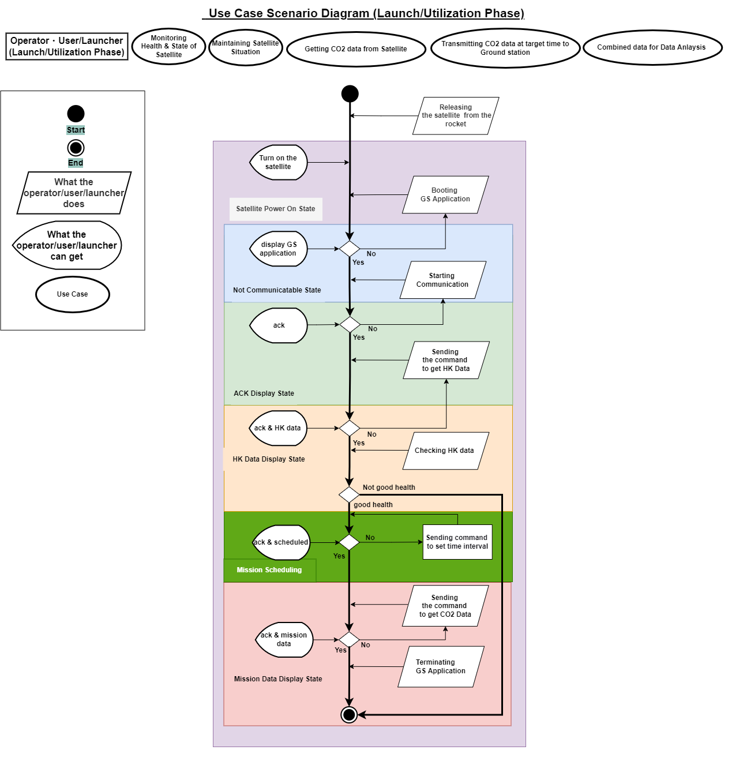
Mission System Design > 2. System Design
2.2 Use Case Scenario Diagram

Slide 9
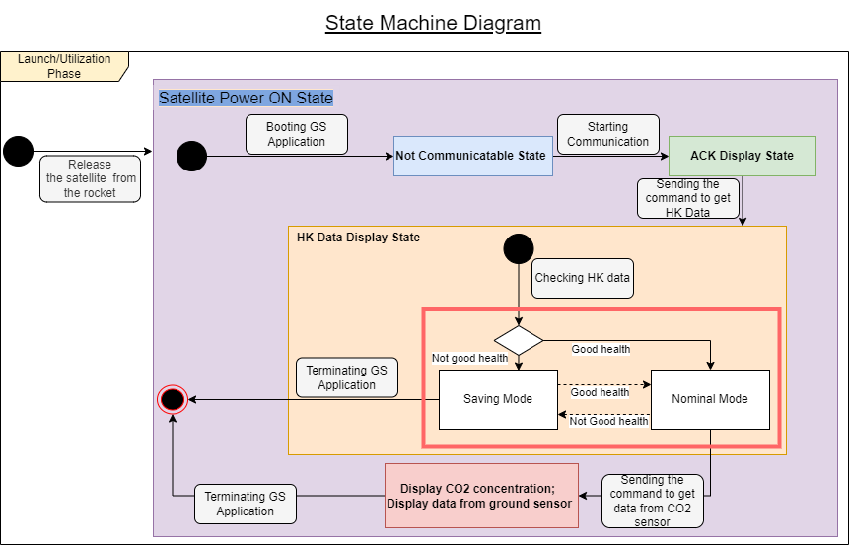
Mission System Design > 2. System Design
2.3 State Machine Diagram

Slide 10
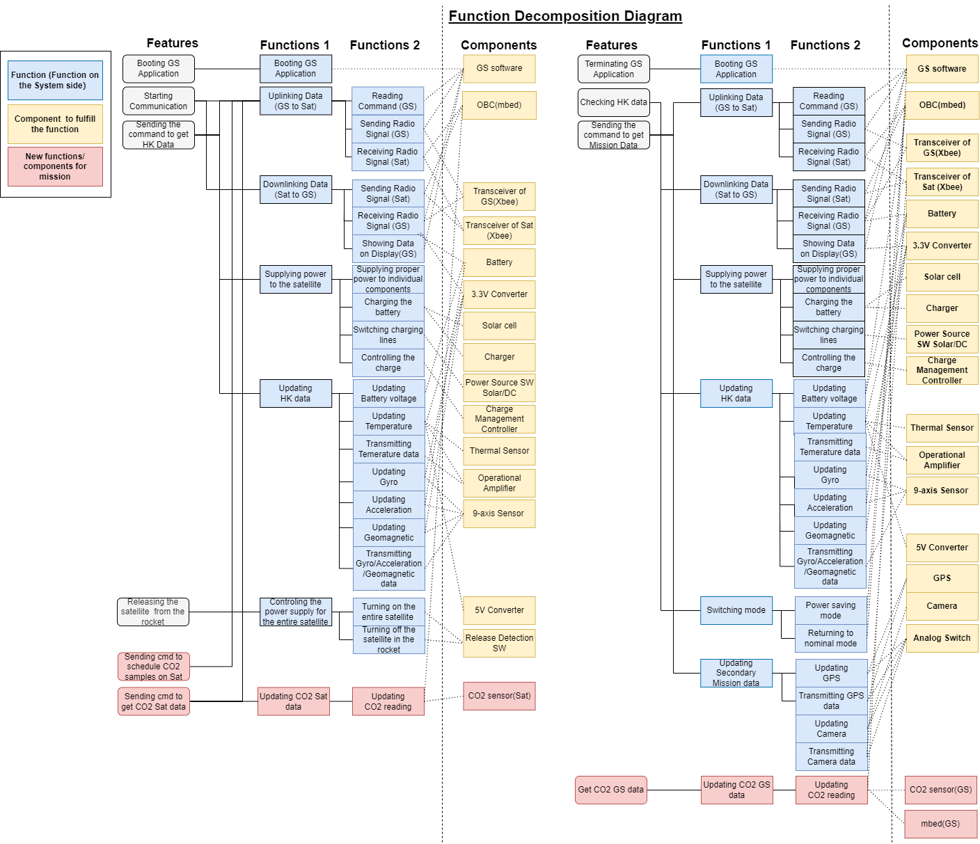
Mission System Design > 2. System Design
2.4 Function Decomposition Diagram

Slide 11
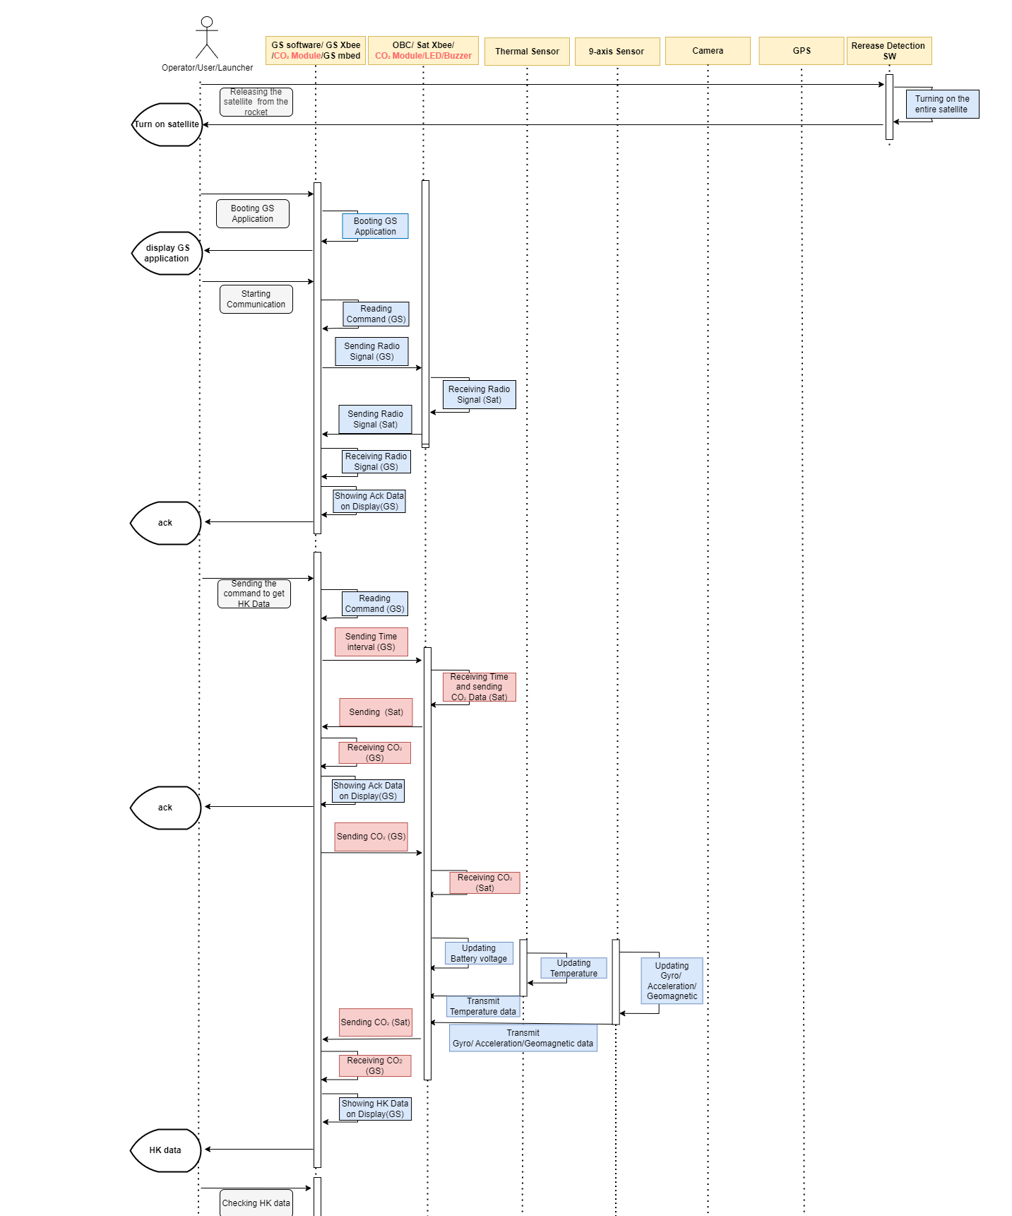
Mission System Design > 2. System Design
2.5 Sequence Diagram

Slide 12
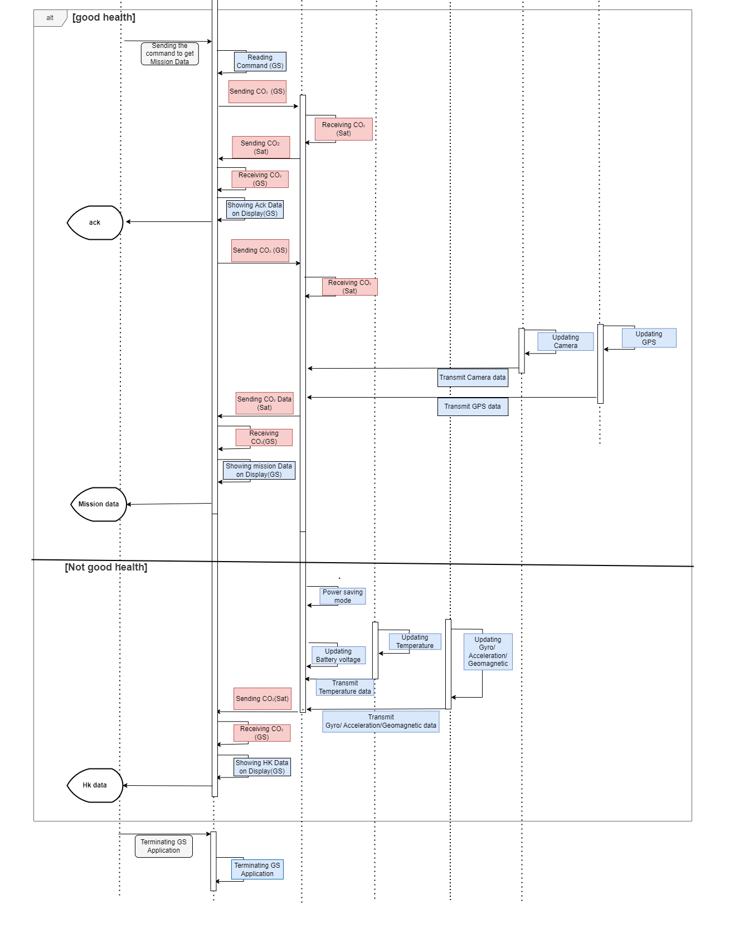
Mission System Design > 2. System Design
2.5 Sequence Diagram

Slide 13
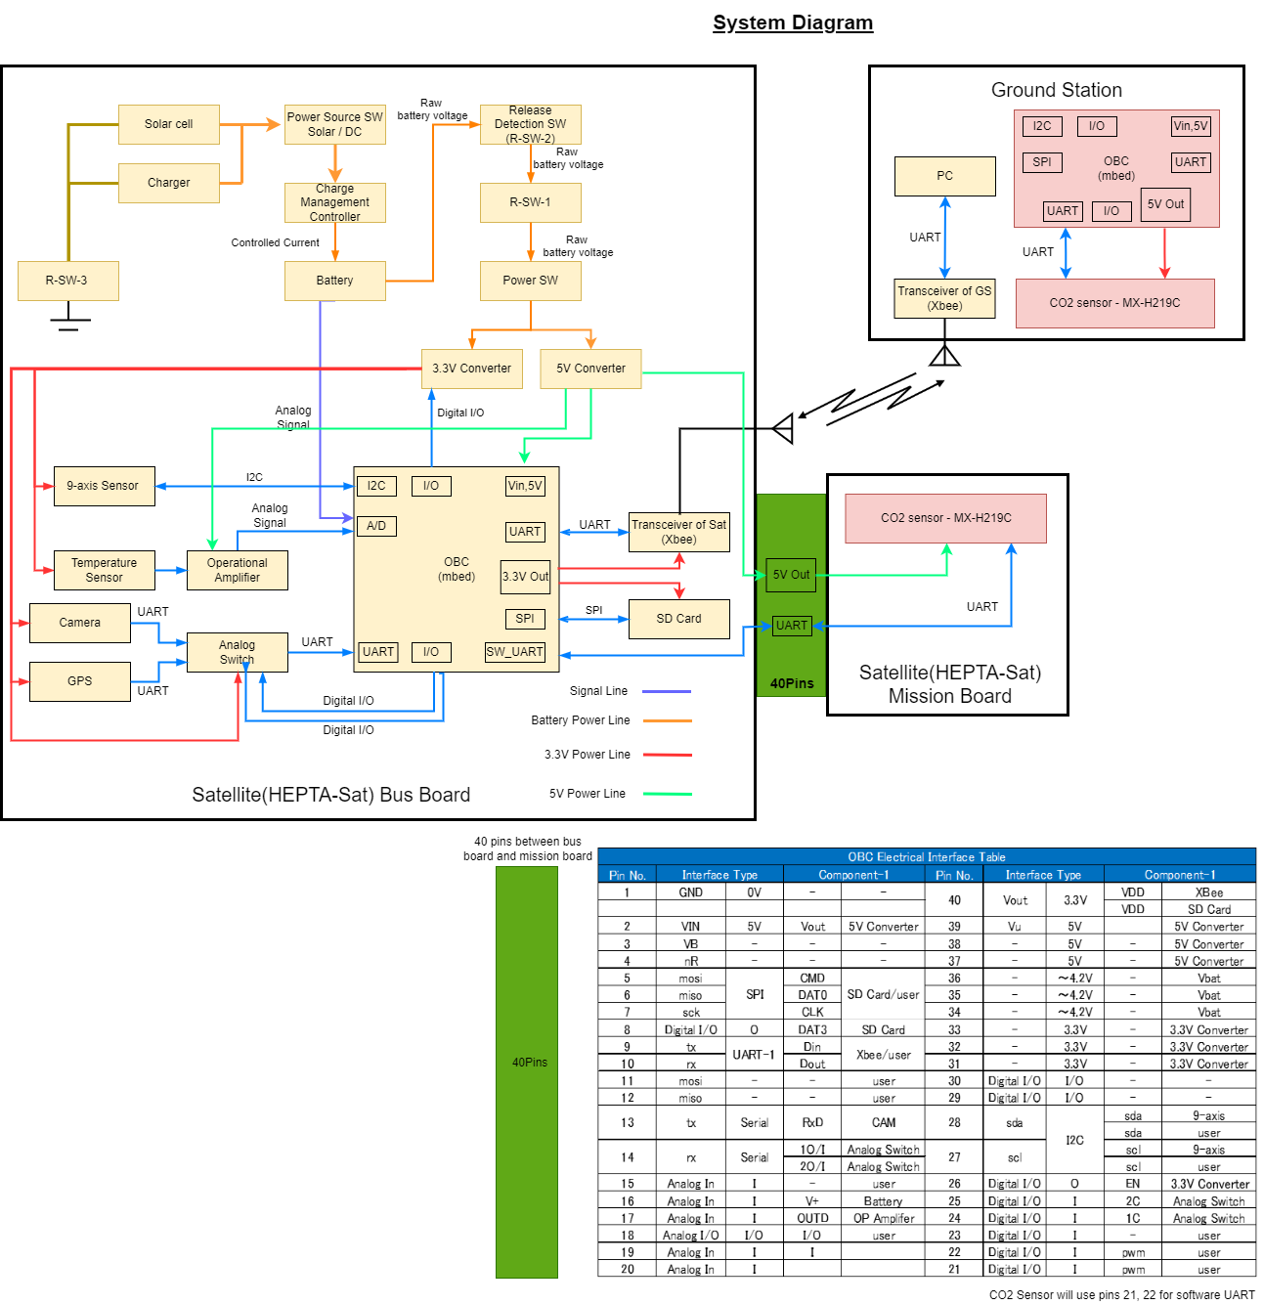
Mission System Design > 2. System Design
2.6 System Diagram

Slide 14
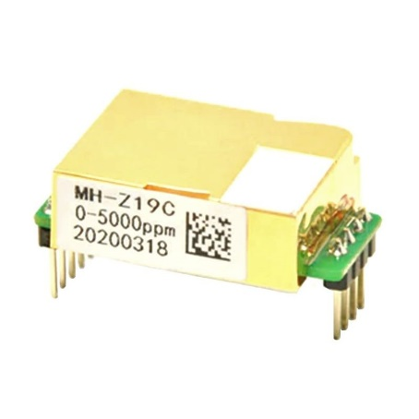
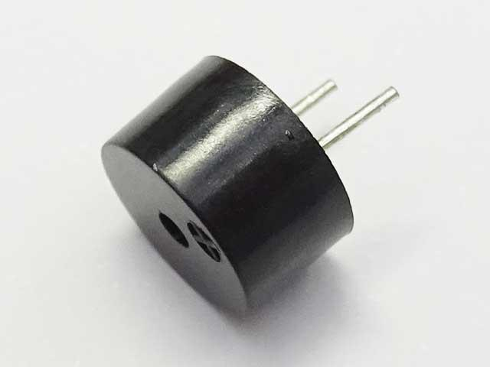

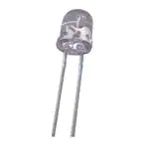
Mission System Design > 2. System Design
2.7 Component Requirement - HeptaSat +
Component | MHZ19C
Target gas | CO2
Voltage | 5 V
Component | UGCM0903EPD
Rated voltage | 3.0 V
Minimum sound | 85 db
Component | Model parachute
Dimension | 0.02x0.02x5 inches
Material | Nylon
Component | C513A LED 5mm
Current | 10mA
Beam width | 60°

Slide 15
Mission System Design > 3. Management
3.1 Cost Management
No. | Components | Model Number & URL | How to get | Qty | Unit Price | Total
1 | Carbon dioxide sensor | MH Z19C | Akizuki | 2 | 2,480 | 4,960
2 | MBED Processor LPC1768 |  | Available | 1
3 | Sound beacon | UGCM0903EPD | Akizuki | 1 | 50 | 50
4 | Parachute | Estes Rockets | Self-made | 1 | 3000 | 3,000
5 | Light led’s |  | Akizuki | 5 | 20 | 100
6 | Hepta-sat |  | Available | 1
7
8
 | Sub Total |  |  |  |  | 8150
 | Tax (10%) |  |  |  |  | 815
 | Grand Total (JPY) |  |  |  |  | 8965

Slide 16
Mission System Design > 3. Management
3.2 Schedule Management
Action Item | Person in charge | Day 1 |  |  |  | Day 2
 |  | 9 | 12 | 15 | 18 | 9 | 12 | 15 | 18
Build/Interface all the elements on to the board
Satellite Software Design and interfacing
Ground Station Interface and Software Design
Python coding and analysis
Testing a) Communication between Satellite to GS b) Sensor Data analysis
Measurements and Analysis

Slide 17
Mission System Design > 3. Management
3.3 Risk Management
- Satellite does not switch on after launch
- Communication uplink not working
- Failure due to integration
- Battery does not charge
- CO2 sensor not working
High
- Satellite GPS measurement not working
- Satellite Camera not working
- Solar panel damage
- (Parachute damage)
-HResources
Degree of impact
Mid
Ground station not working
Low
Low
Mid
High
Probability

Slide 18
Mission System Design > 3. Management
3.3 Risk Management
Risk | Countermeasures
Satellite does not switch on after launch | Test release mechanism thoroughly to have lowest possible risk - also test release in cold vacuum to check for possible cold welding of release switch
Communication uplink not working | Test communication over long enough distance to verify all connections with antennas integrated
Battery does not charge | Integrate battery level within software to monitor chagring and optimize usage. Test battery charging and solar panel interface thoroughly.
CO2 sensor not working | Do proper ground testing. There should be no jamming for CO2 sensor, protect from dirt by working in clean room only.
Satellite GPS measurement not working | Thoroughly test on ground to verify functionality. Test with GPS simulator to verify functioning at high velocities/altitudes.
Satellite Camera not working | Thoroughly test on ground to verify connections, lens integrity due to vibrations
Ground station not working | Test thoroughly and have spare parts available for repairs.

Slide 19
…table of contents
Mission Statement
System Design
Management
Demonstration
4.1 Experimental Setup: Planned vs Performed
4.2 Experimental Results
Physical – Parachute
Physical – CO2 GS Mode
Physical – LEDs, Sound
Operational – Satellite Bus Verification
Operational – CO2 Sensors
Operational – LEDs, Sound
Operational – Python GS User Interface
Functional – CO2 Software: Node + GS
Functional – Parachute release with dummy weight
Functional
End to End Testing – CO2 Sensor
End to End Testing – LEDs for Landing
End to End Testing - System
4.3 Summary of Success Evaluation
Conclusion

Slide 20
Mission System Design > 4. Demonstration
4.1 Experimental Set-up - Planning vs Performed
Exp 1 - Hepta-Sat with ground station setup as per textbook instructions
Battery charging and power supply will be verified - Completed
Communication will be verified by transmitting commands - Completed
9-Axis functionality will be verified - Completed
GPS will be verified - Completed
Exp 2 - With added CO2 sensor system functionality is tested
First with both satellite and GS next to each other, should have the same CO2 measurements from both - Completed for GS node only
Next test with satellite removed from ground station, to verify CO2 measurement scheduling, sampling and data transfer - Data transfer of dummy data only, no scheduling
Move satellite to other CO2 environment - enclosed, or controlled, or at different altitude. Check that CO2 levels measured by satellite change - Used GS node as proxy for satellite, tested indoors, outdoors, different altitudes (floor indoors), breath test
Exp 3 - For secondary mission(s)
Attach parachute and test if images give enough detail to be useful - Parachute not attached due to risk, parachute reliability tests completed
Simulate satellite movement and then put down on still surface, check if recovery support of LEDs and Sound are activated - Completed

Slide 21
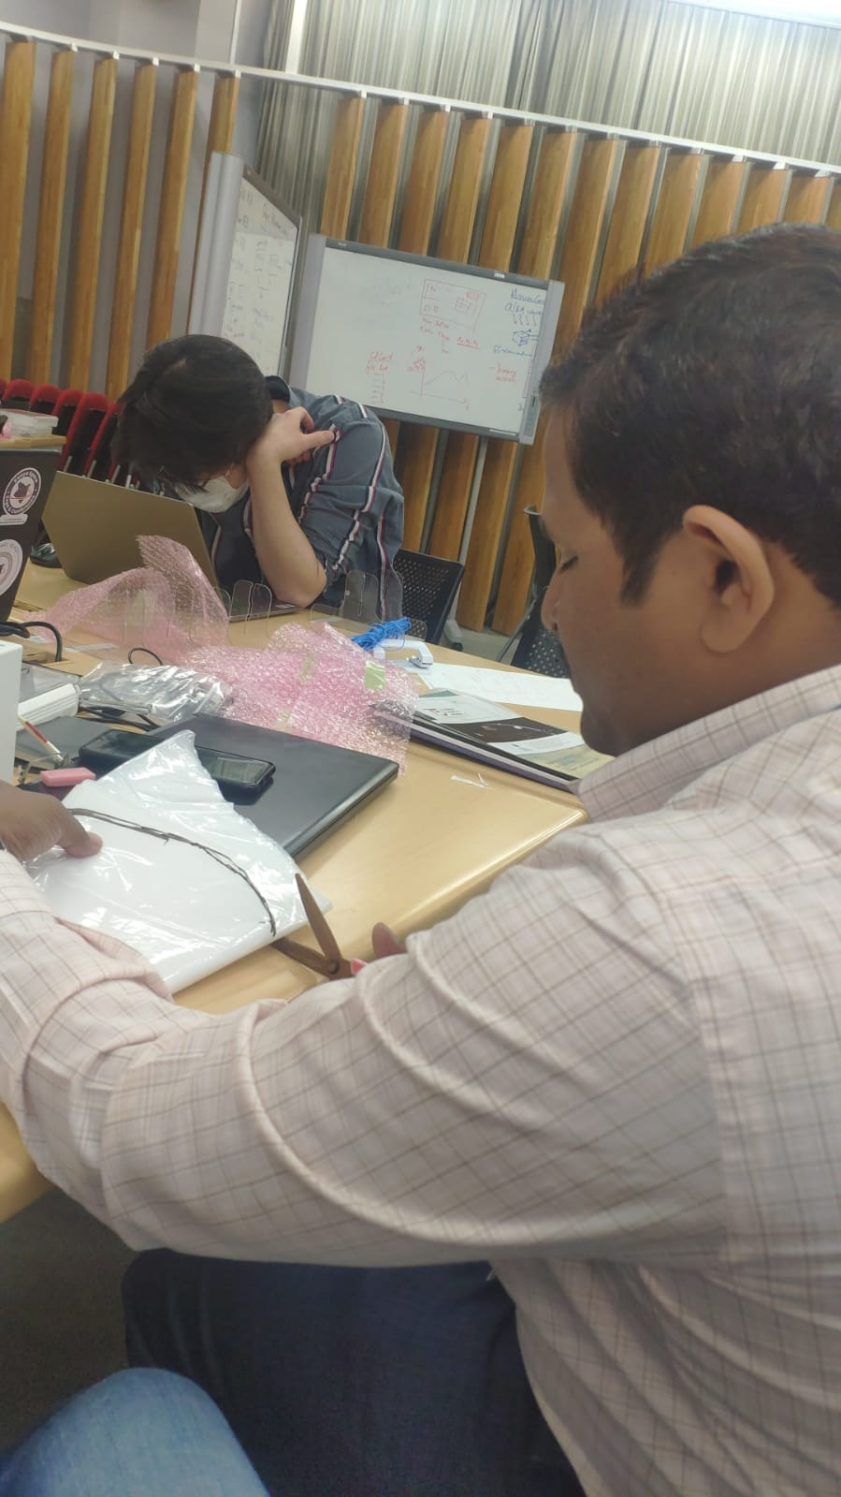

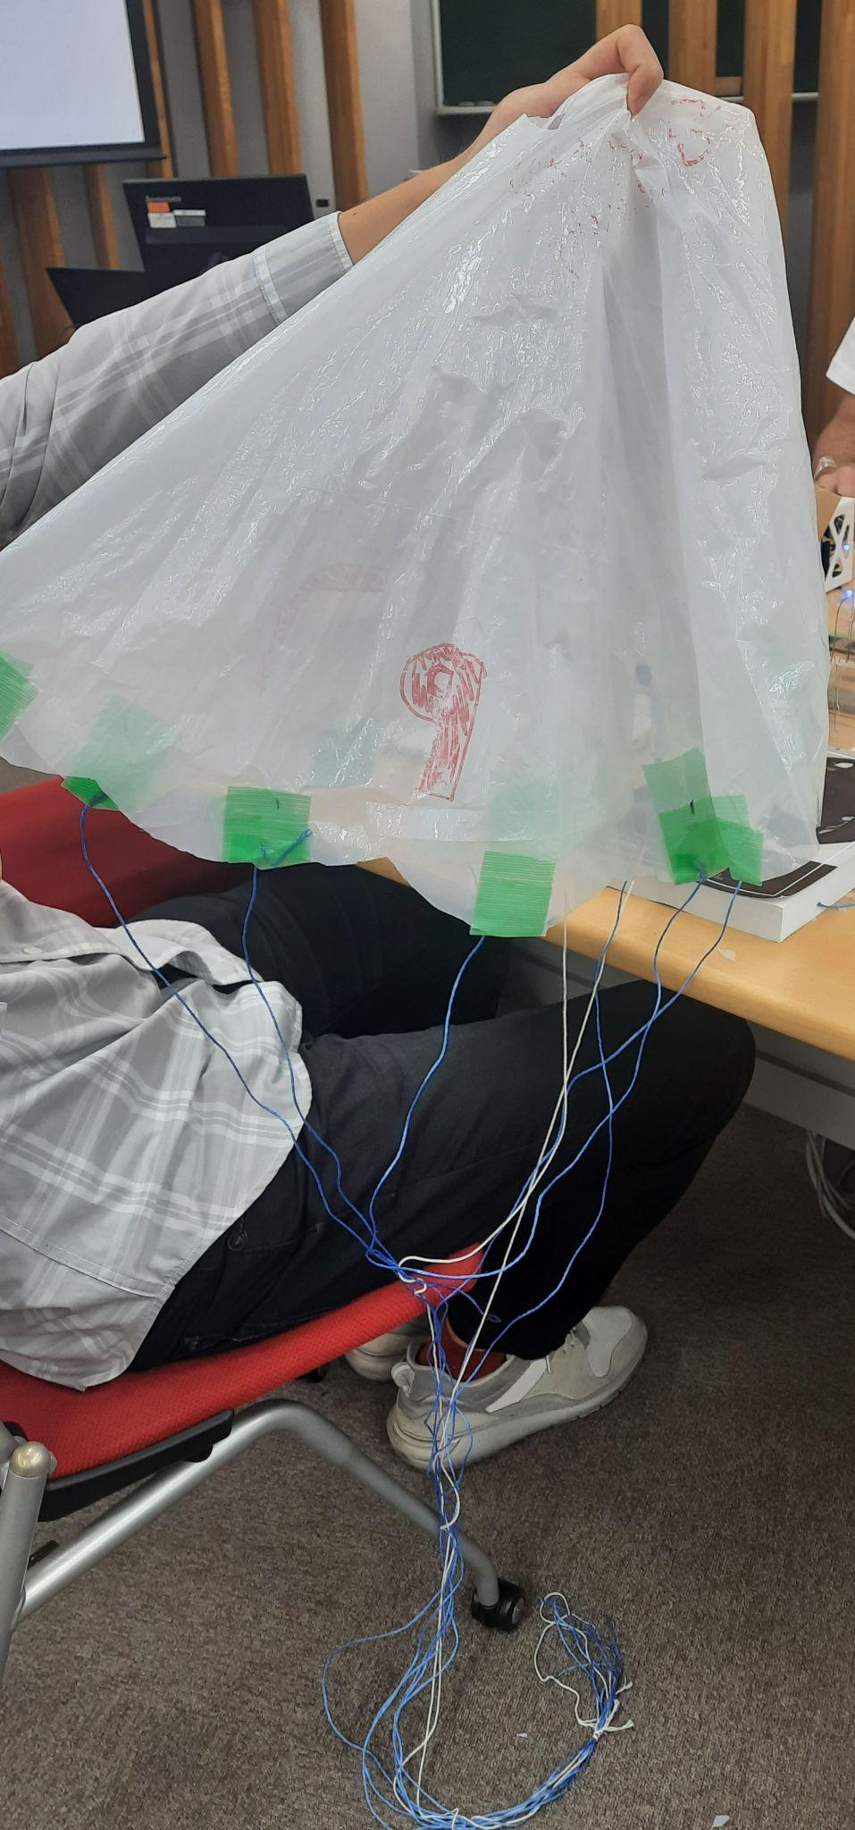
Mission System Design > 4. Demonstration
4.2 Experimental Result - Physical - Parachute
Diameter :90 Cm
Threads Used: 8
Weight: 100 ML water bottle

Slide 22
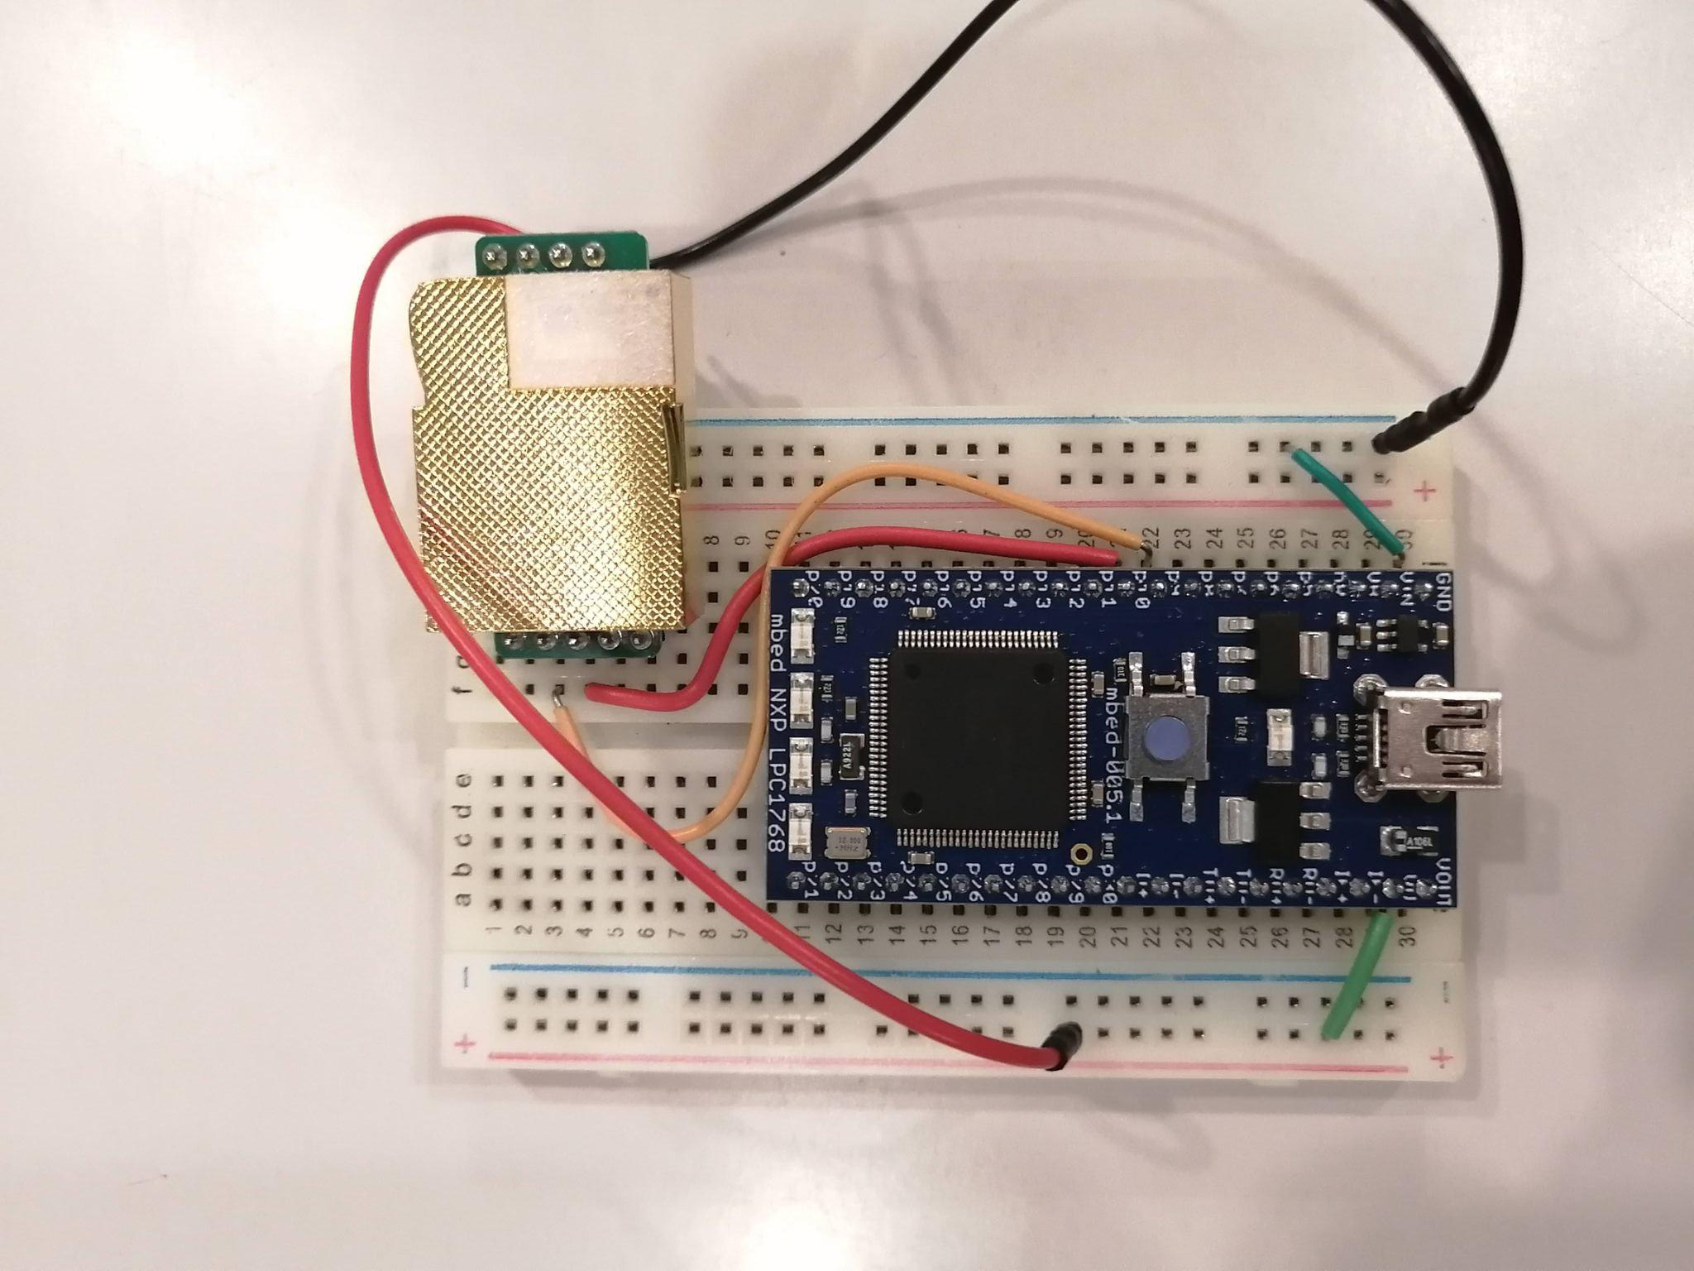
Mission System Design > 4. Demonstration
4.2 Experimental Result - Physical - CO2 GS node
CO2 sensor and MBED micro integrated

Slide 23
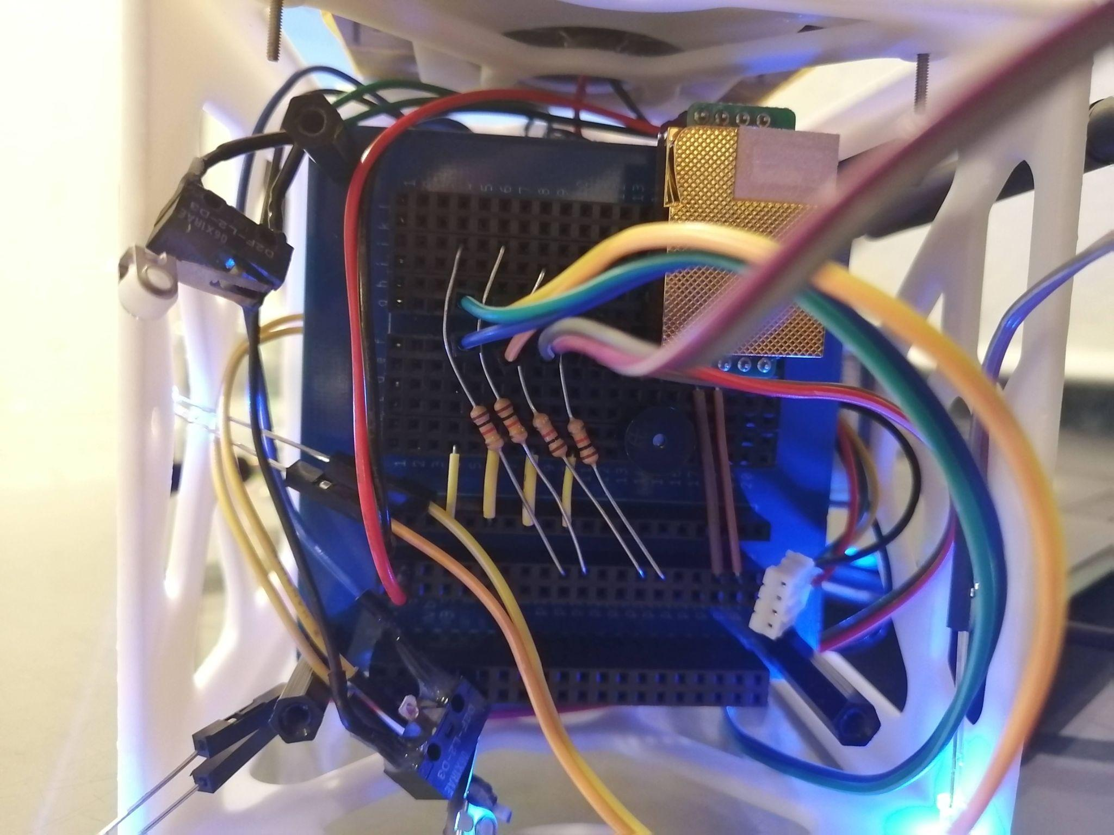
Mission System Design > 4. Demonstration
4.2 Experimental Result - Physical - LEDs, Sound
CO2 sensor
LED wires and series resistors

Slide 24
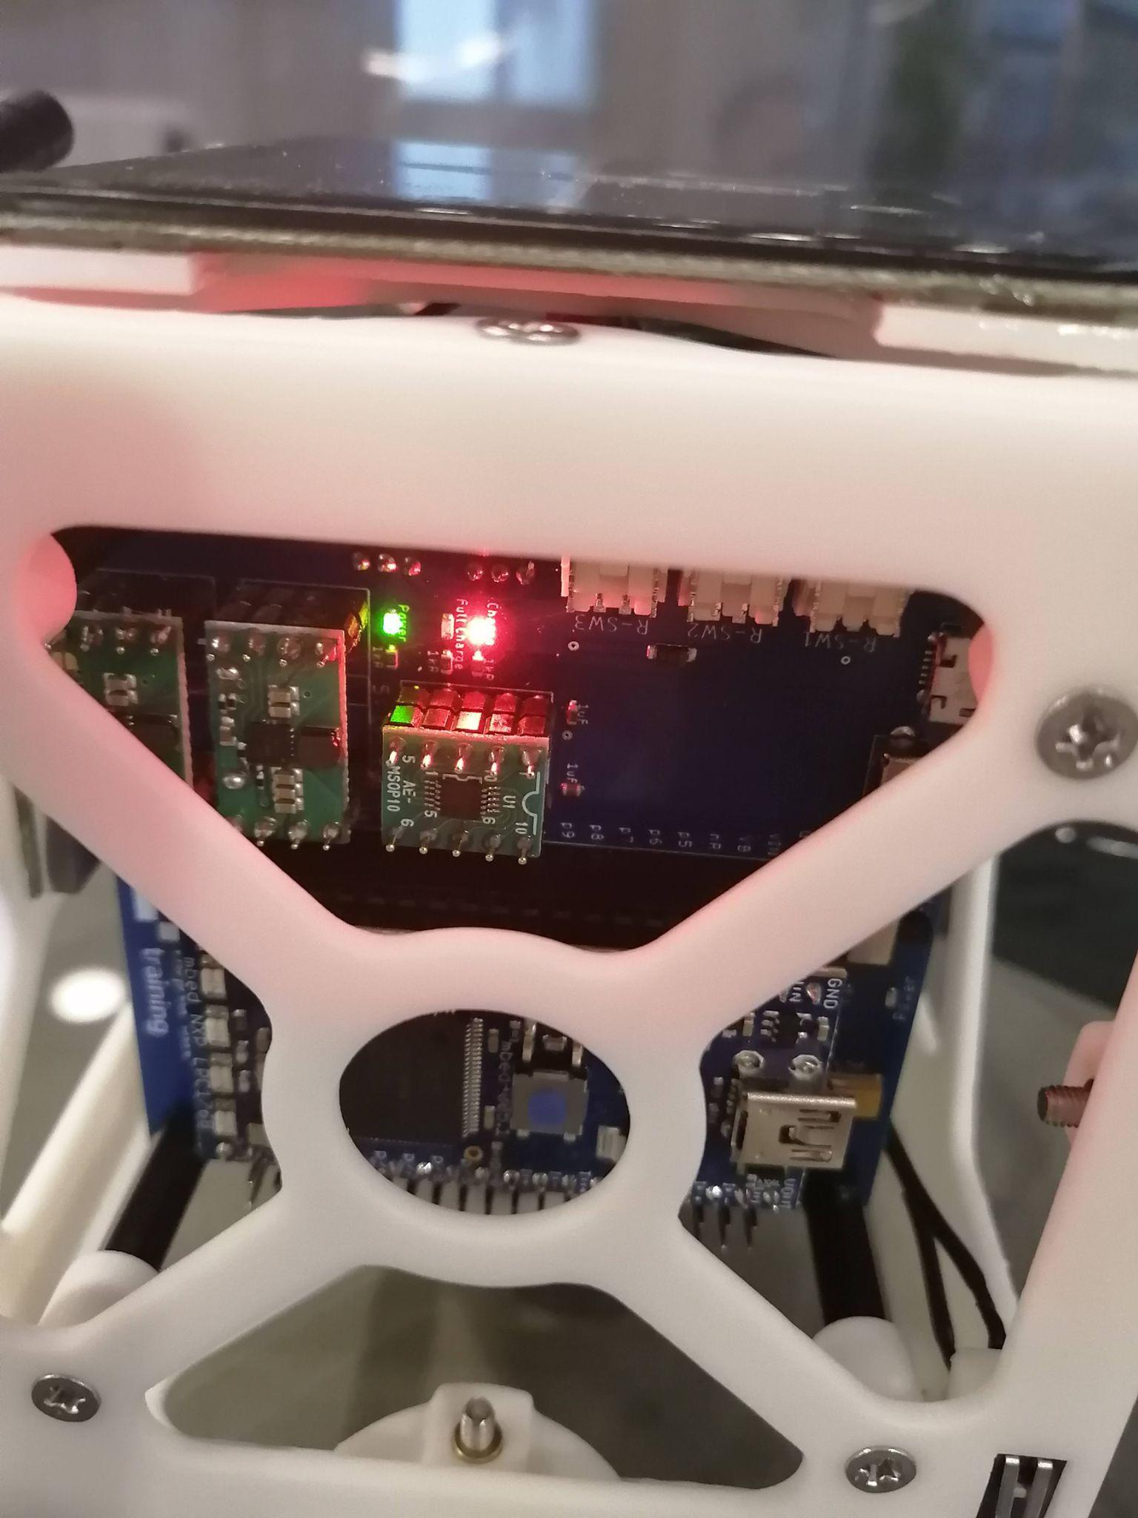
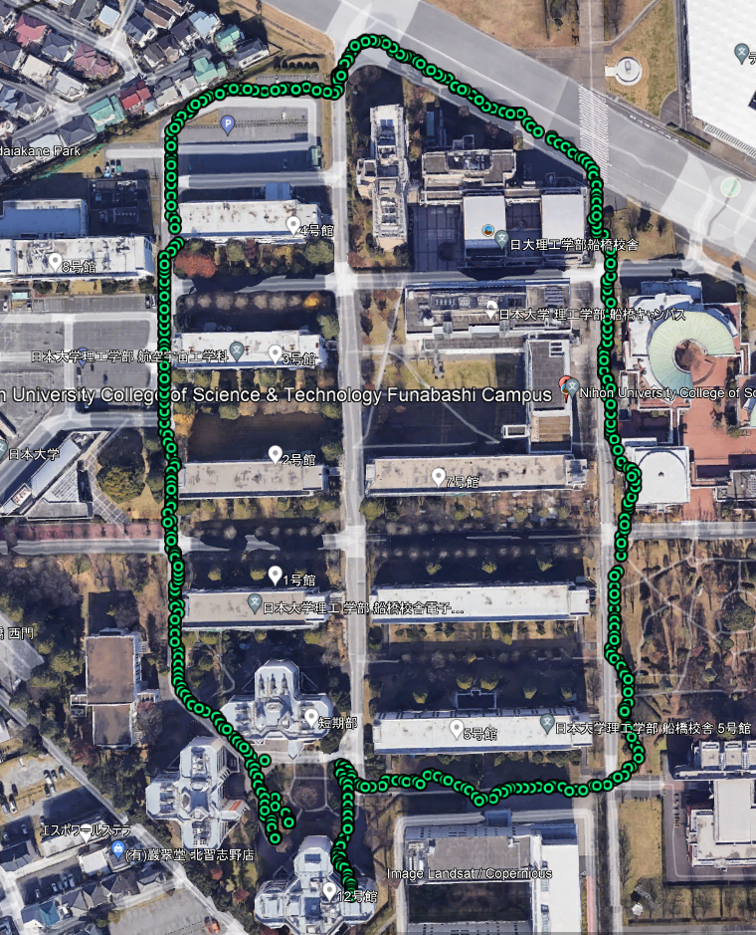
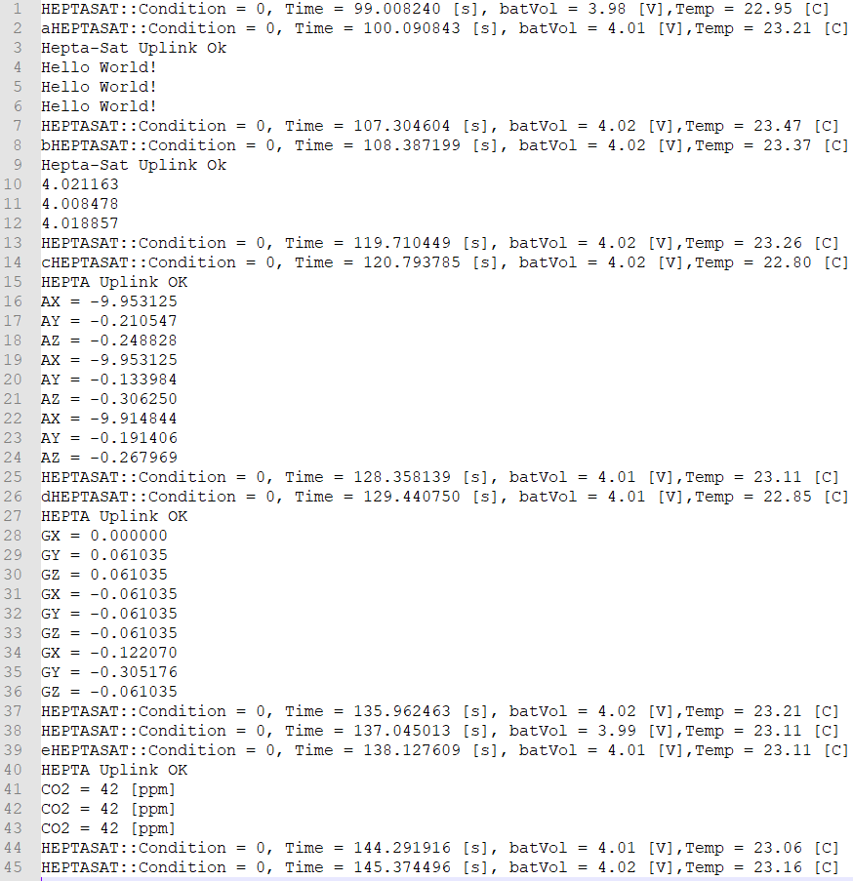

Mission System Design > 4. Demonstration
4.2 Experimental Result - Operational (1/4) - Satellite Bus Verification
Charging, power, 9-axis, GPS, Camera, Communication

Slide 25
Mission System Design > 4. Demonstration
4.2 Experimental Result - Operational (2/4) - CO2 sensors
GS setup - serial comms and protocol
Software was developed
Tested independently of satellite
Completely functional
Integration in satellite - serial comms and protocol
Software developed
Tested with satellite bus software
Protocol fully functional
CO2 interface non-functional

Slide 26
Mission System Design > 4. Demonstration
4.2 Experimental Result - Operational (3/4) - LEDs and Sound
LED integration in satellite - Software control
Landing detection software completely functional
Sound sensor integration in satellite - Software control
Sound Sensor not completed

Slide 27
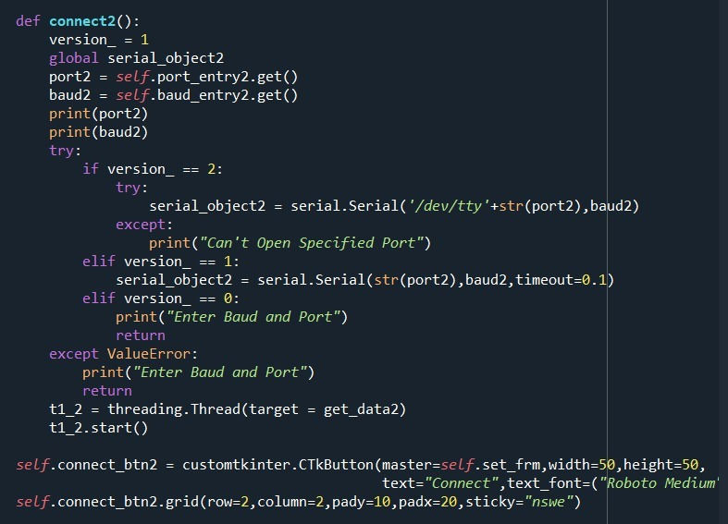
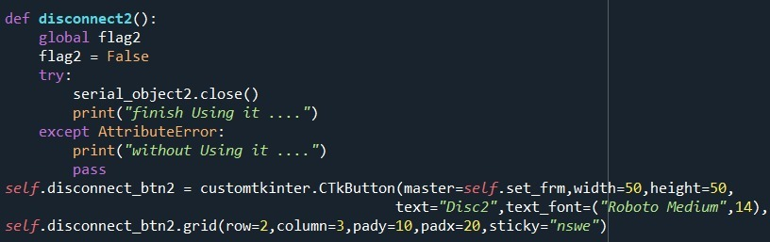
Mission System Design > 4. Demonstration
4.2 Experimental Result - Operational (4/4) - Python GS GUI
Updated Python code snippets

Slide 28
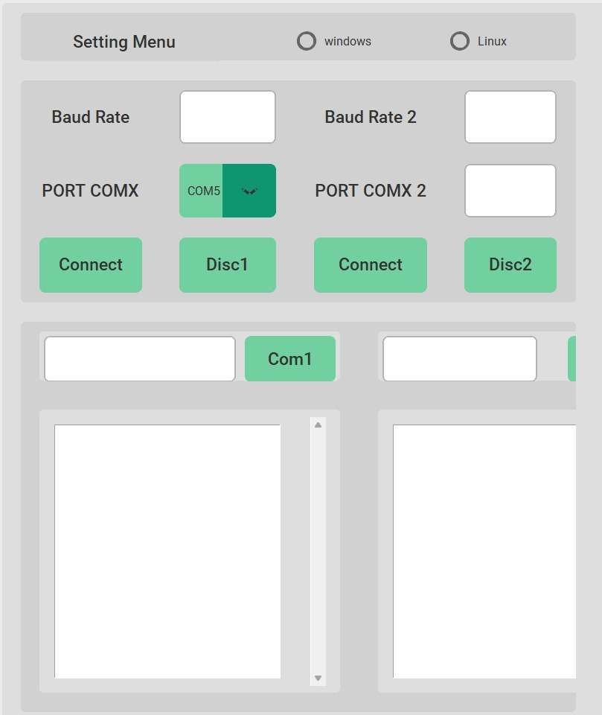
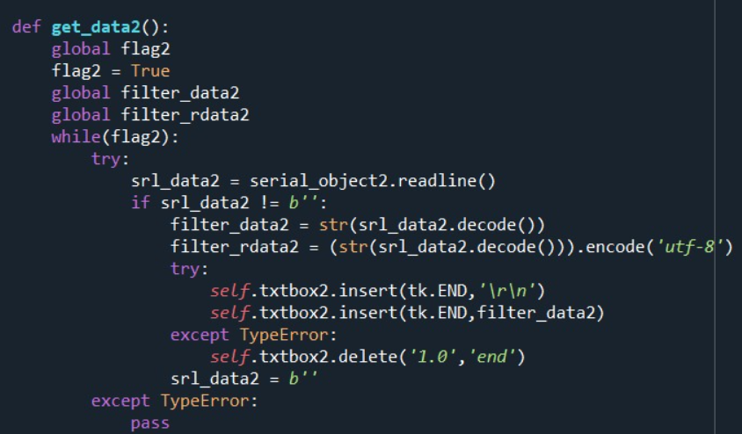
Mission System Design > 4. Demonstration
4.2 Experimental Result - Operational (4/4) - Python GS GUI
GS GUI Development and testing
added functionality for second comms channel to CO2 sensor
partial success, UART comms for second channel not displayed
Expanded Python User interface

Slide 29
Mission System Design > 4. Demonstration
4.2 Experimental Result - Functional (1/4) -
CO2 Software: Node + GS
Descriptions + pictures with annotations
CO2 to GS comms/ to sat comms
Power on test
CO2 sending (using scope)
CO2 response (using scope)
Sat comms SW approach - limited functionality

Slide 30
Mission System Design > 4. Demonstration
4.2 Experimental Result - Functional (2/4) -
Parachute release with dummy weight
Parachute release tests using dummy weight

Slide 31
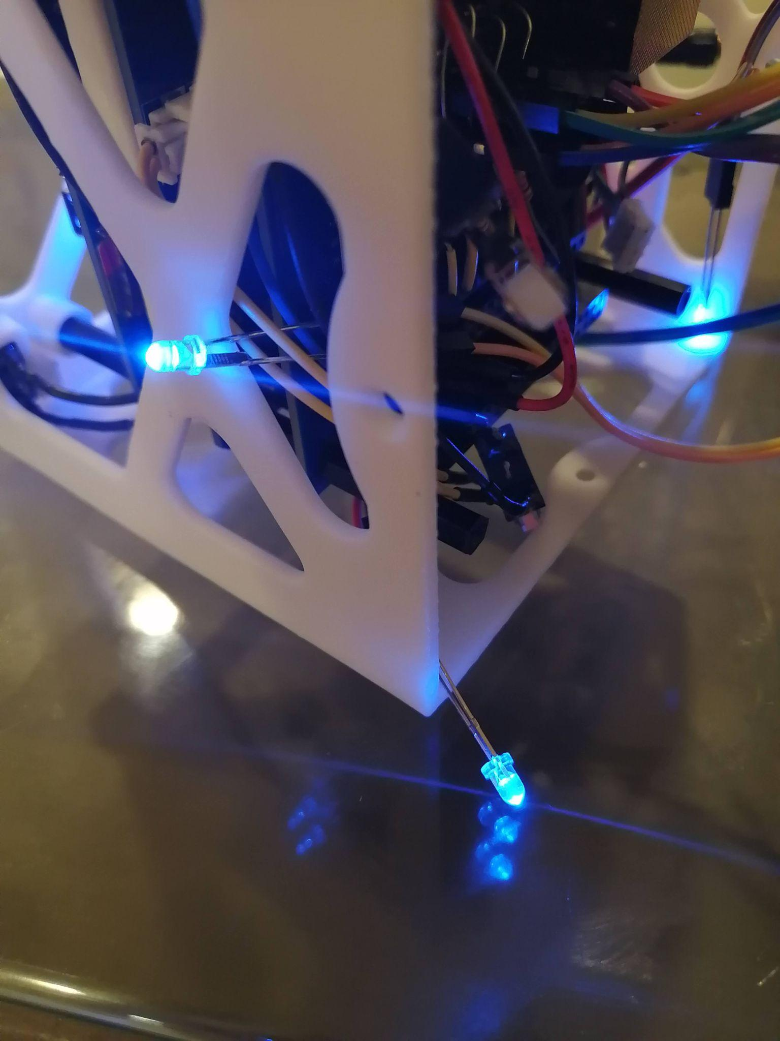
Mission System Design > 4. Demonstration
4.2 Experimental Result - Functional (3/4) - LEDs and Sound
Descriptions + pictures with annotations
LEDs test for brightness / Sound Test

Slide 32
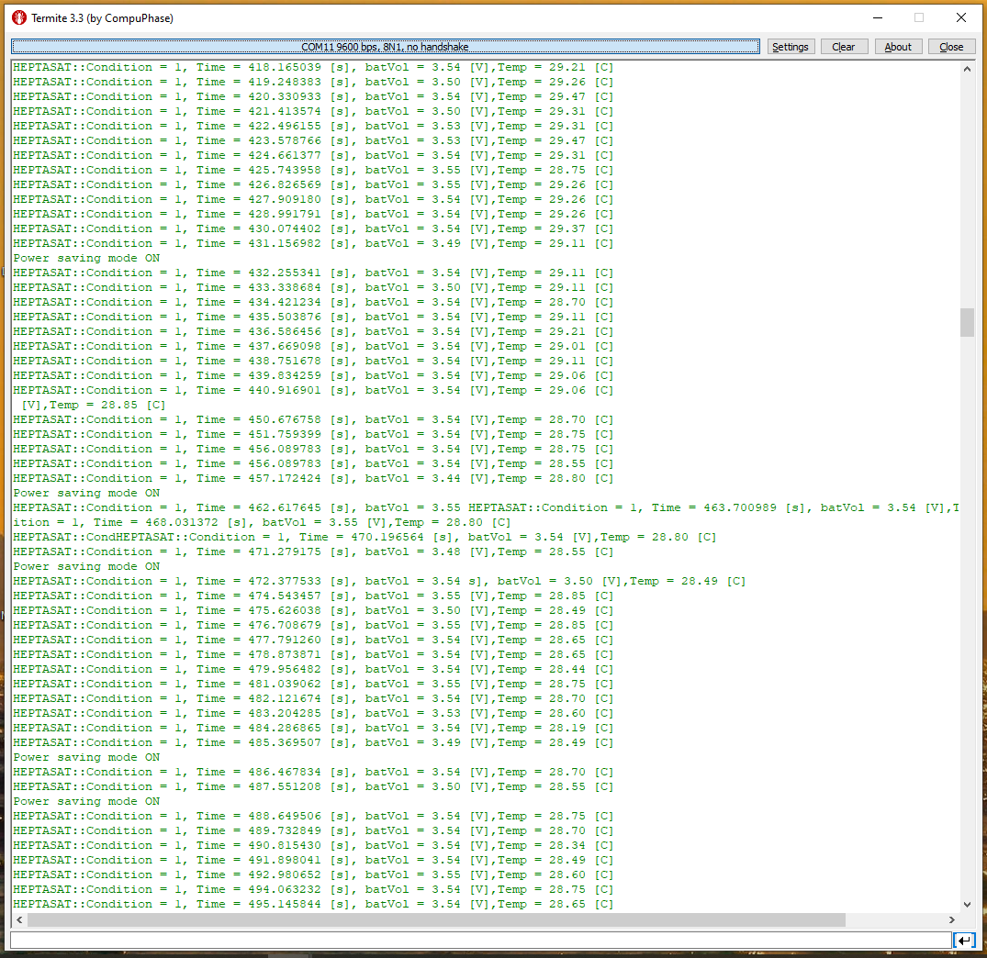
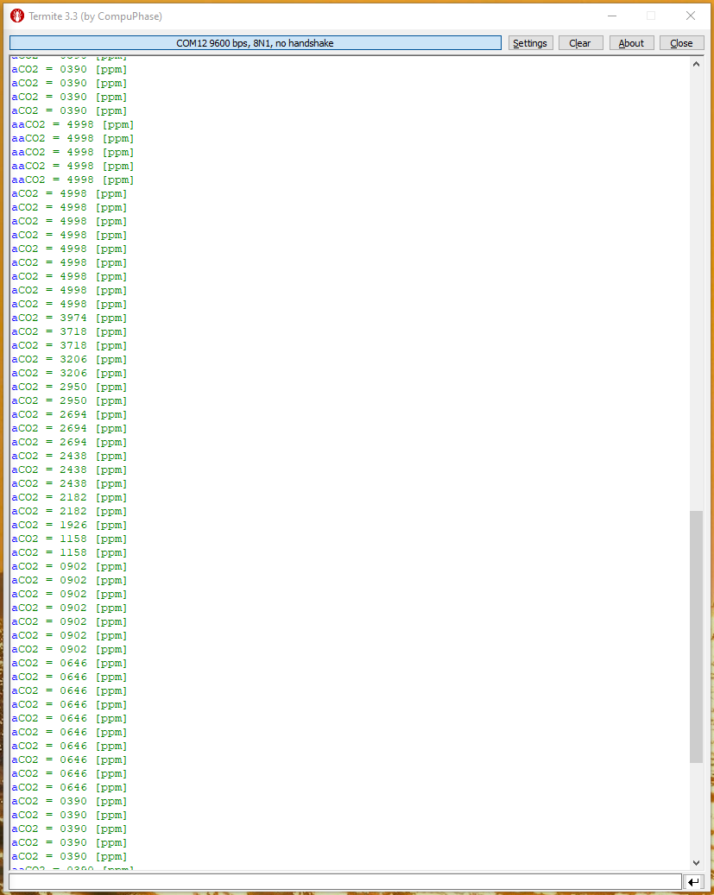
Mission System Design > 4. Demonstration
4.2 Experimental Result - Functional
Descriptions + pictures with annotations
GS protocol functionality using terminals
Satellite Terminal
GS Node Terminal

Slide 33
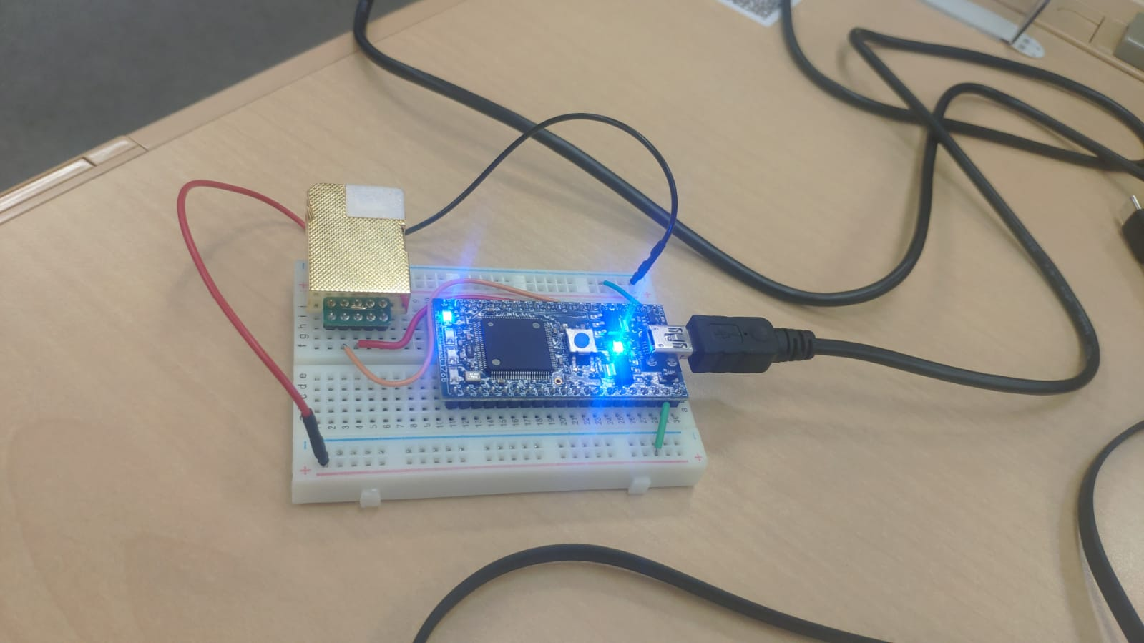
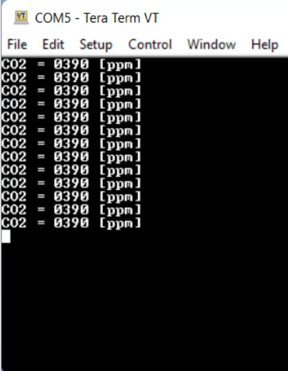
Mission System Design > 4. Demonstration
4.2 Experimental Result - End-to-end testing (1/3) - CO2 sensor
CO2 GS Node
Measuring CO2 levels on the ground station
CO2 Measured results at GS

Slide 34
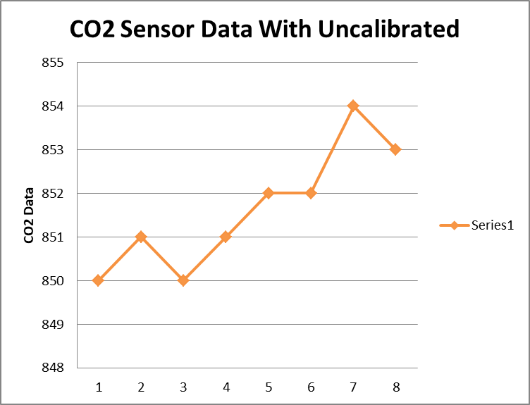
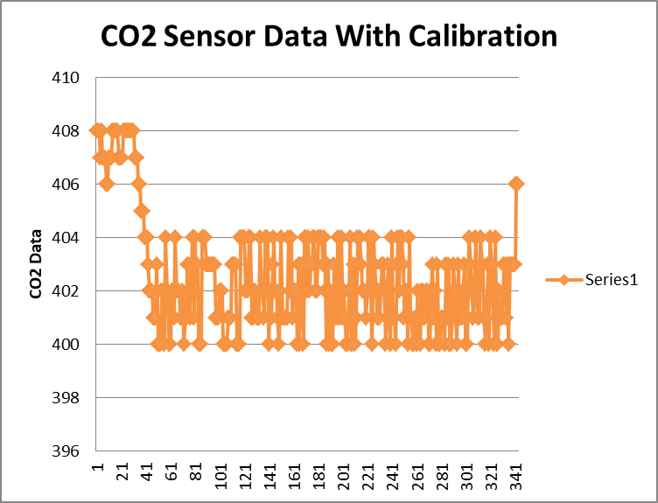
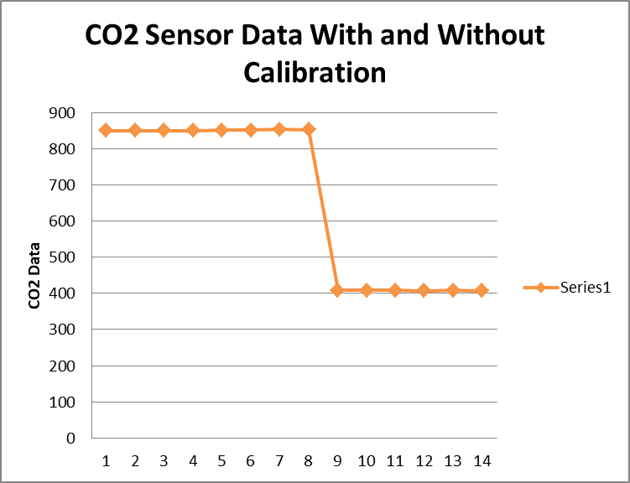
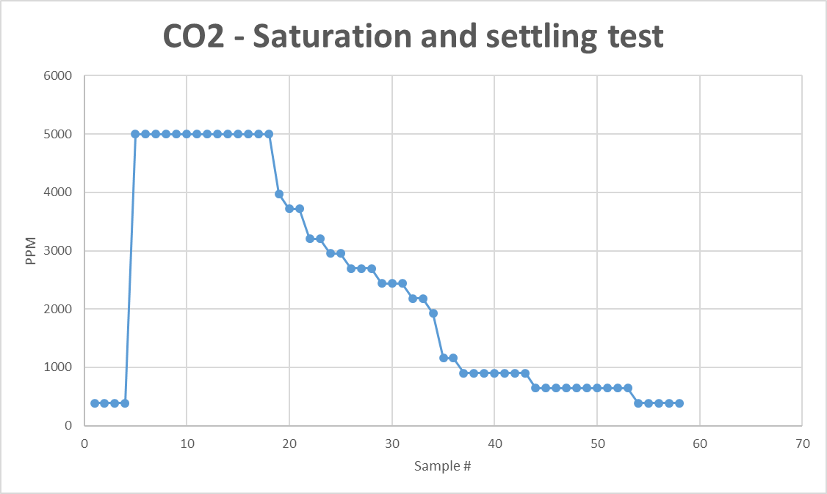
Mission System Design > 4. Demonstration
4.2 Experimental Result - End-to-end testing (1/3) - CO2 sensor

Slide 35
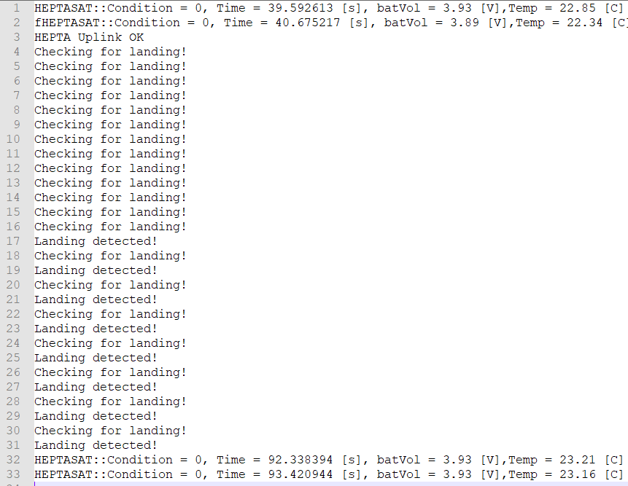
Mission System Design > 4. Demonstration
4.2 Experimental Result - End-to-end testing (2/3) - LEDs for landing

Slide 36
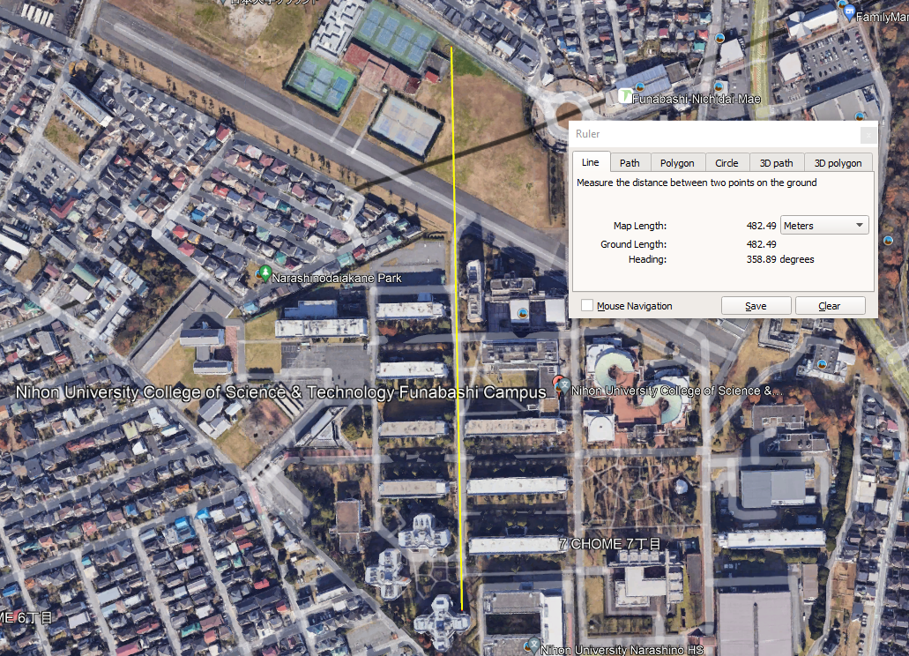
Mission System Design > 4. Demonstration
4.2 Experimental Result - End-to-end testing - (3/3) - System
Full GS communications - Sat and CO2 node (using terminals)
Communications range test

Slide 37
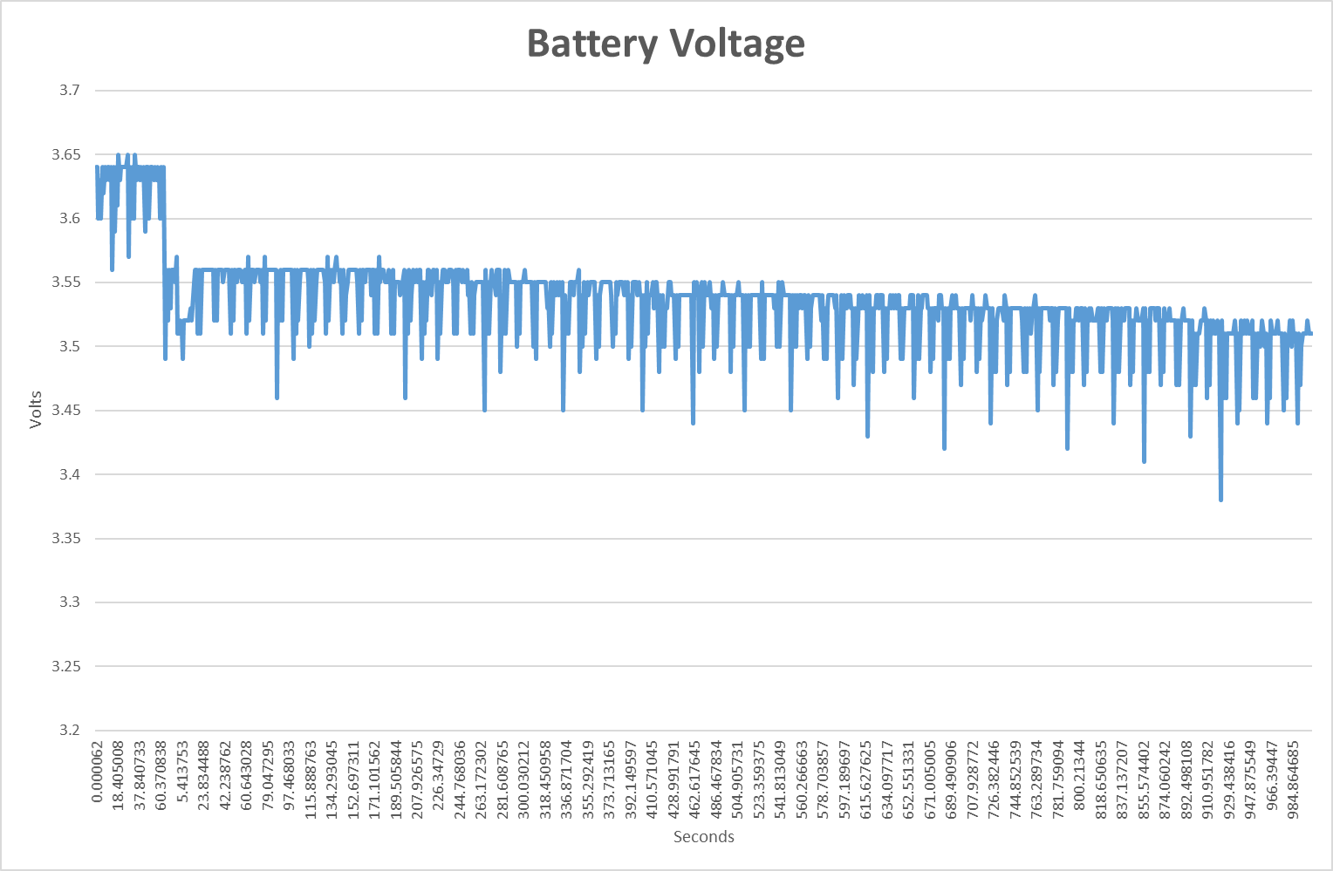
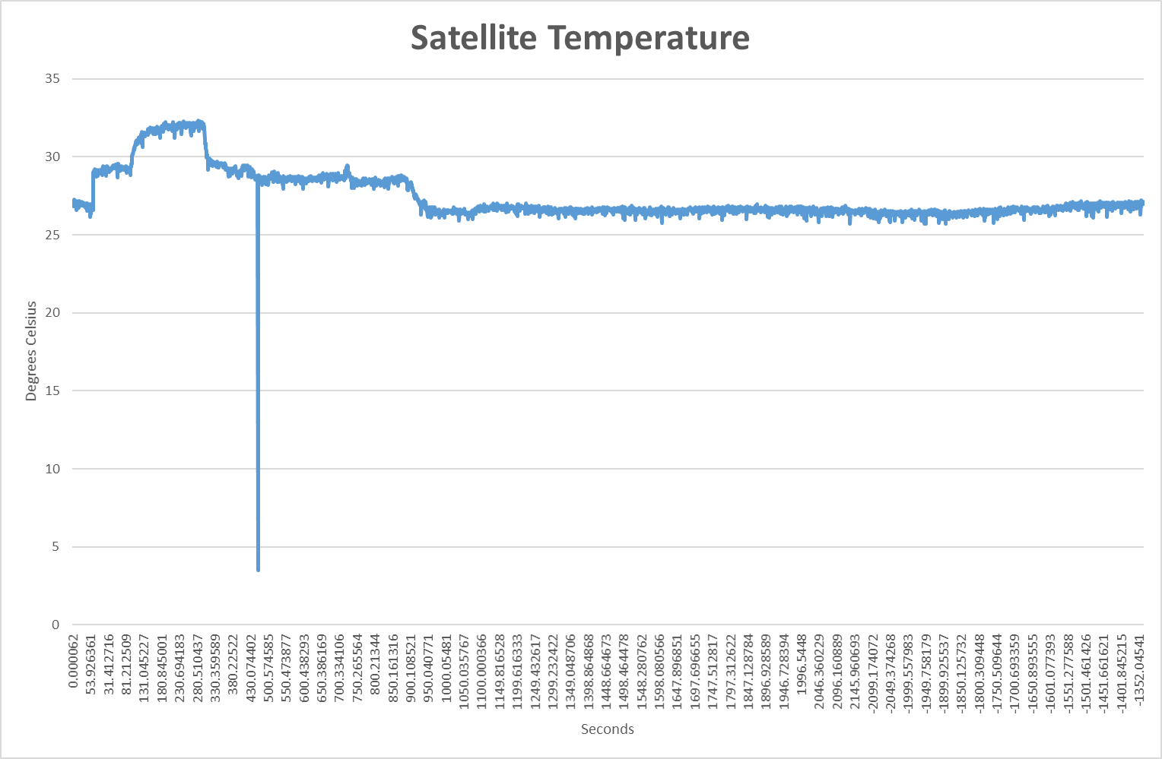
Mission System Design > 4. Demonstration
4.2 Experimental Result - End-to-end testing - (3/3) - System
Full GS communications - Sat and CO2 node (using terminals)
Communications range test
While monitoring power
and temperature

Slide 38
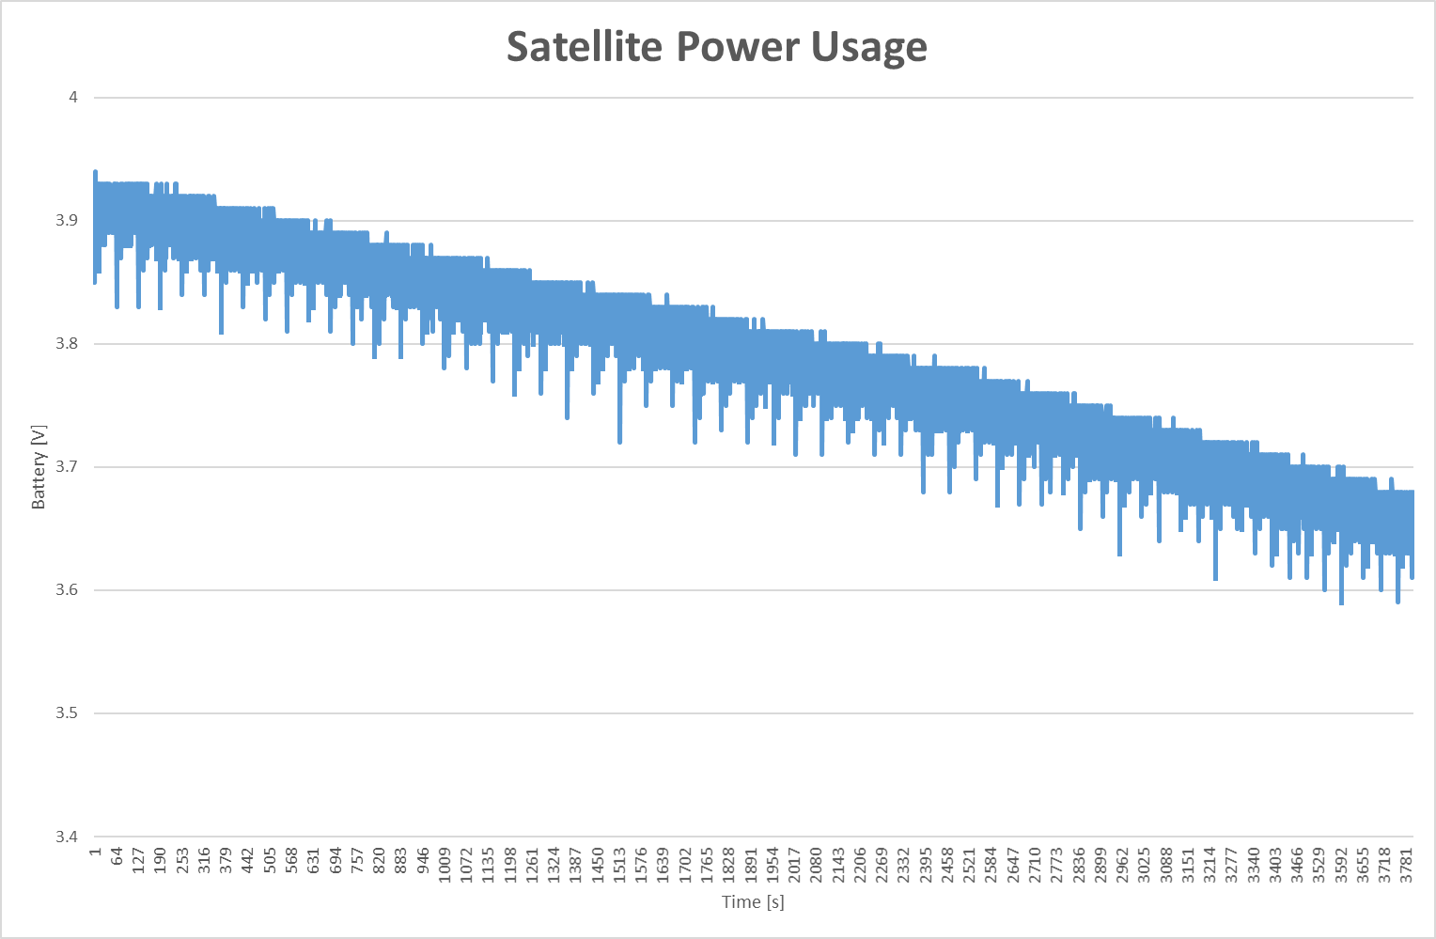
Mission System Design > 4. Demonstration
4.2 Experimental Result - End-to-end testing - (3/3) - System
Reliability testing on software = > 1hr continuous satellite-GS operation

Slide 39
Mission System Design > 4. Demonstration
4.3 Summary of Success Evaluation
Success Level | Goal No. | Mission Success Criteria | Verification Method | Result
Minimum Success | 1 | Establish the communication between Stellite and GS | Switch on the satellite and House Keeping Data Received | Success
 | 2 | Get the CO2 data from Satellite | CO2 data from Satellite is Received Successfully | Partial
 | 3
Full Success | 4 | Establish the communication between Stellite and GS | Switch on the satellite and House Keeping Data Received multiple | Success
 | 5 | Get the CO2 data from Satellite at the specified interval of time to GS | CO2 data from Satellite is Received Successfully | Fail
 | 6 | Detect landing condition | LED and Sound data received | Partial
Advanced Success | 7 | Establish the communication between Stellite and different GS | Switch on the satellite and House Keeping Data Received continuous | Success
 | 8 | Get the CO2 data from Satellite at the specified interval of time from Different GS and Compare the results | CO2 data from Satellite is Received to all the GS station Successfully | Partial
 | 9 | Detect landing condition and measure the force of impact of the ground (through acceleration) | LED and sound data is received | Fail

Slide 40
Mission System Design > 5. Conclusion
5. Conclusion
Was schedule planning appropriate? – Yes, but unforeseen challenges caused
the overall schedule not to be met
Was resource planning appropriate? – Yes.
Were risk identification and – Mostly, software development time was
countermeasures appropriate? not identified as a significant risk.
Was team communication appropriate? – Yes.
What was accomplished? – Full payload integration and test cycle
was experienced.
– One complete CO2 node and one partial onboard CO2 sensor.
– Fully functional bus and communication including payload data
What was learned? – Documentation takes time
– Software development can take more
time than expected
What is future work? – Improve GS software framework
– Better quality CO2 sensor
– Improved parachute to do complete drop test

